Slide 1

Student details
-Name:- Ankit Kumar Singh
-Skills build Email ID:- ankitsisodiya623@gmail.com
-Collage Name:- Roorkee Institute Of Technology, Roorkee
-Internship Domain:- Front end Development
-Internship start and end date:- 12/06/2023 to 24/07/2023

Slide 2
Zomato clone

Slide 3
Project topic:
-using this web application we are trying to solve real-world problems.
-You can order your food with your phone anywhere at any time.
-We are committed to delivering good and fresh quality food.

Slide 4
Agenda:
Food Delivery:-Zomato primarily focuses on providing food delivery services, connecting customers with local restaurants, and facilitating the delivery of food orders. They aim to provide a seamless and efficient food delivery experience for their users.
Restaurant Discovery:- Zomato helps users discover and explore restaurants in their area. Their platform includes restaurant listings, menus, user reviews, ratings, and photos to assist users in making informed decisions about where to dine out or order food from.
Expansion and Growth: Zomato has been expanding its operations globally. They have a presence in multiple countries and continue to explore new markets and regions. Their agenda likely includes identifying opportunities for expansion, entering new cities, and increasing their market share.
Customer Satisfaction and Retention: Providing a satisfactory user experience and retaining customers are likely important aspects of Zomato's agenda. They may prioritize customer support, quality control, and implementing measures to ensure customer satisfaction.

Slide 5
Project Overview:
It’s a Zomato clone web application that is built by using technology like HTML5, CSS, and JavaScript.
Purpose:
1. Food Delivery
2. Restaurant Discovery
3. Expansion and Growth
4. Technology and Innovation
5. Customer Satisfaction and Retention
Scope:
The scope of Zomato primarily revolves around its core services of food delivery and restaurant discovery

Slide 6
End-user:
Food Enthusiasts: People who enjoy exploring different cuisines, trying out new restaurants, and discovering unique dining experiences. They use Zomato to search for restaurants, read reviews, and make informed decisions about where to dine.
Busy Professionals: Individuals with demanding schedules who prefer the convenience of ordering food for delivery or pickup. Zomato provides them with a wide selection of restaurants and menu options, making it easier to satisfy their culinary preferences without spending time on cooking or grocery shopping.
Students: Students often rely on food delivery services due to their busy academic schedules. Zomato offers them a convenient way to order meals from nearby restaurants, allowing them to focus on their studies while enjoying a variety of food options.
Families and Households: Zomato is also used by families and households who want to enjoy meals together without cooking or going out. They can order food for delivery from a range of cuisines and restaurants, accommodating different preferences within the household.
Travelers: People who are visiting new cities or countries may use Zomato to explore local cuisine and find restaurants that suit their preferences. Zomato's restaurant discovery feature helps travelers make dining choices based on reviews, ratings, and location

Slide 7
Problem & solution:
Restaurant Discovery: Zomato helps consumers discover restaurants in their area. It provides comprehensive information about restaurants, including menus, reviews, ratings, photos, and contact details. This solves the problem of uncertainty or lack of information when trying to decide where to eat.
Food Delivery Convenience: Zomato offers a convenient platform for consumers to order food for delivery from a wide range of restaurants. This solves the problem of limited food options or the need to cook when individuals may not have the time, ingredients, or inclination to prepare a meal.
Time-Saving: Zomato saves consumers time by eliminating the need to physically visit multiple restaurants or make phone calls to place food orders. Users can browse through menus, customize orders, and make payments online, all within the Zomato app or website.
Reviews and Ratings: Zomato provides a platform for users to read and contribute reviews and ratings for restaurants. This helps consumers make informed decisions about where to dine or order food based on the experiences of others. It solves the problem of uncertainty or disappointment that can arise from choosing a restaurant blindly.
Increased Visibility for Restaurants: Zomato offers restaurants an online presence and exposure to a wide audience. Restaurants can showcase their menus, photos, and customer reviews, helping them attract new customers and increase their visibility. This solves the problem of limited marketing reach and helps restaurants stand out in a competitive industry.
Delivery Logistics: For restaurants that offer delivery services, Zomato provides a platform that handles the logistics of food delivery. It connects restaurants with delivery partners, streamlining the delivery process and ensuring efficient and timely delivery of orders. This solves the problem of managing in-house delivery operations for restaurants.
Table Reservations: Zomato's table reservation feature allows users to book tables at participating restaurants. This solves the problem of waiting for a table or uncertainty about getting a seat at a restaurant during peak hours, enhancing the dining experience for consumers.

Slide 8
Unique features:
User-Generated Content: we encourage users to contribute their reviews, ratings, photos, and recommendations for restaurants. This user-generated content creates a vibrant and interactive platform where people can share their dining experiences and insights with others. It sets Zomato apart by providing a robust database of user opinions and feedback.
Foodie Community: we have cultivated a community of food enthusiasts, often referred to as "foodies." This community aspect allows users to follow each other, interact with fellow food lovers, and discover new restaurants and dishes through recommendations from like-minded individuals. The social networking aspect of Zomato enhances the overall user experience and creates a sense of belonging.
Food Events and Meetups: we organize food-related events, meetups, and collaborations with restaurants and chefs. These events provide opportunities for users to engage with the local food scene, try new dishes, and connect with others who share their passion for food. This unique feature sets Zomato apart by offering offline experiences that go beyond the traditional online food delivery model.
Collections and Food Guides: we curate collections and food guides based on different themes, cuisines, or occasions. These curated lists help users discover trending restaurants, hidden gems, and popular dishes in their area. The emphasis on curation and personalized recommendations distinguishes Zomato as a platform that goes beyond basic listings.
Zomato Gold: Zomato Gold is a subscription program that offers exclusive deals, discounts, and perks at partner restaurants. Subscribers can enjoy complimentary dishes or beverages or get discounts on their total bill. This unique loyalty program sets Zomato apart by providing additional value to its users and encouraging them to try new restaurants.

Slide 9
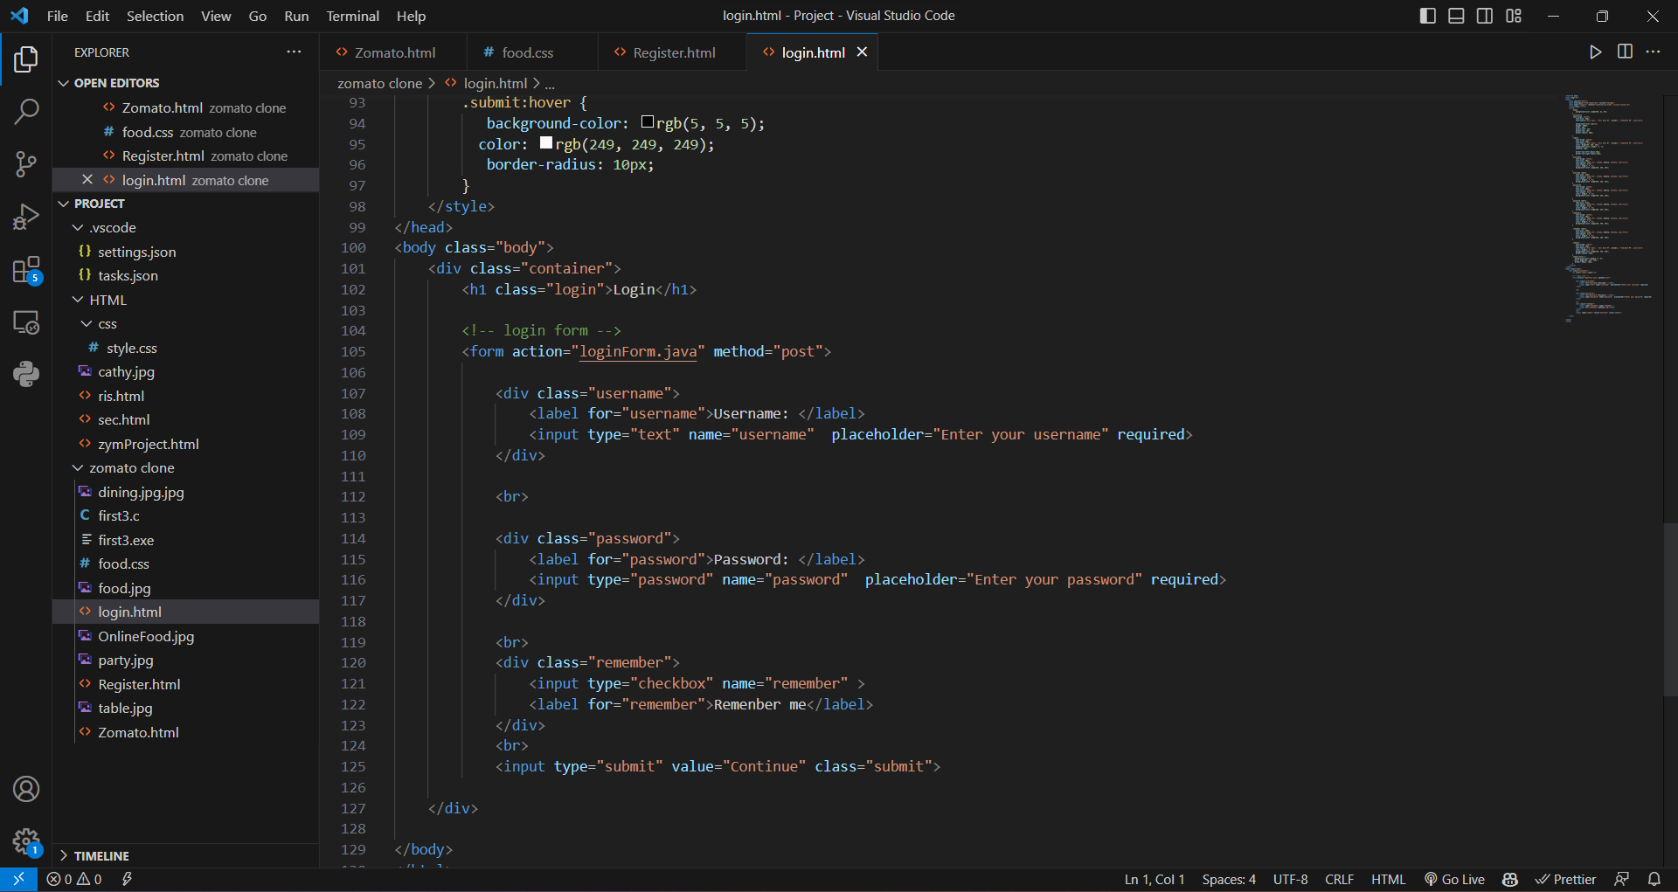
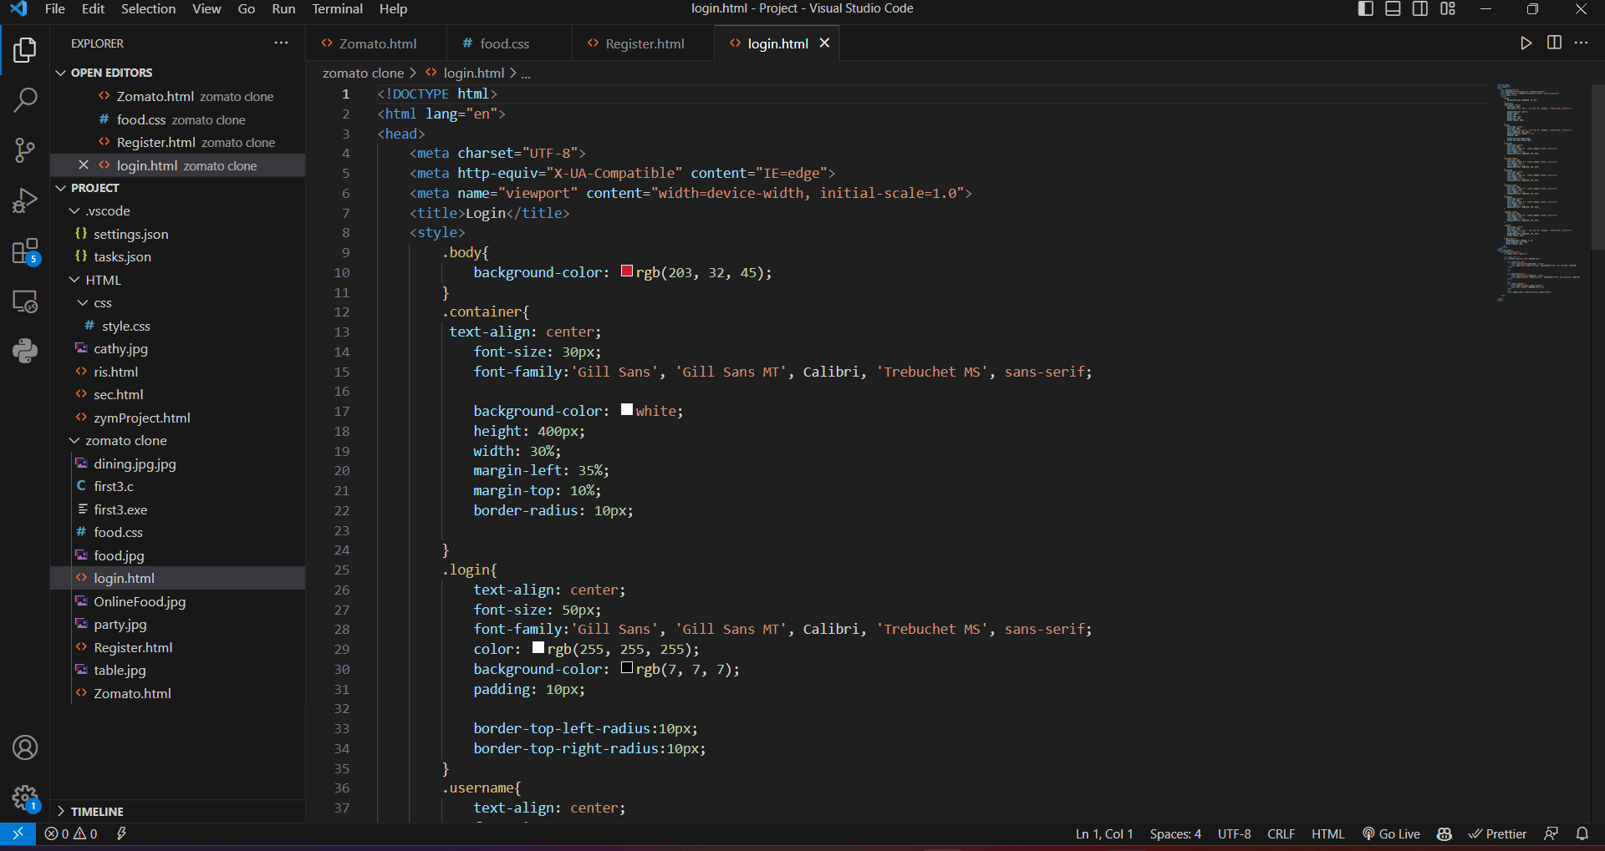
Modeling:
Codes:-

Slide 10
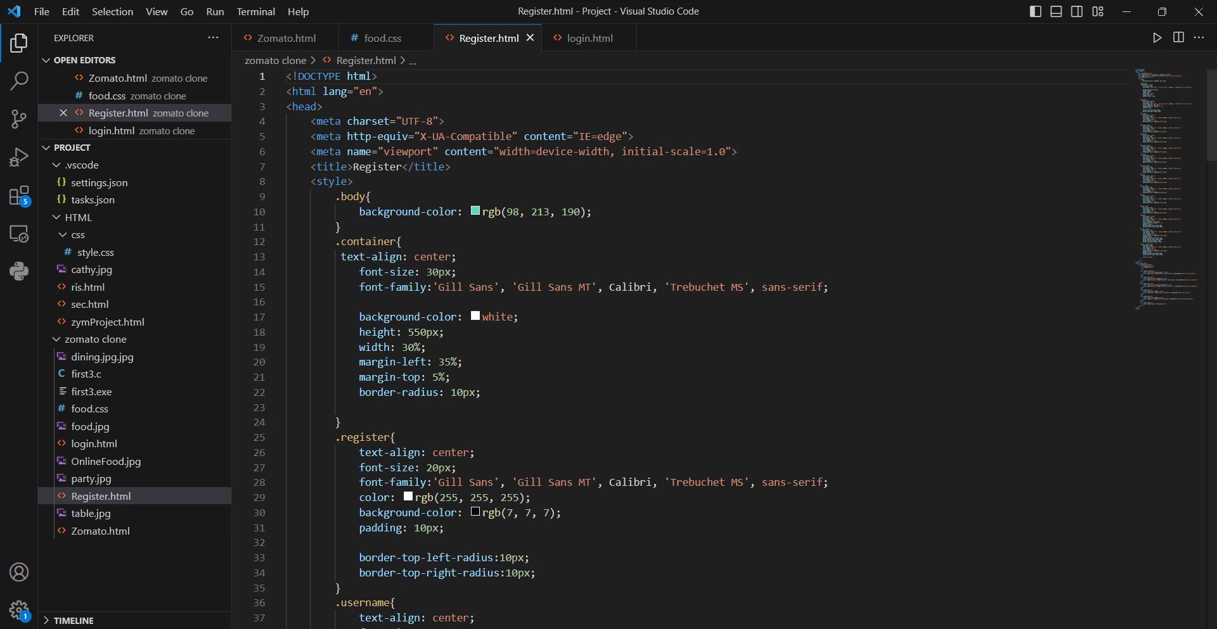
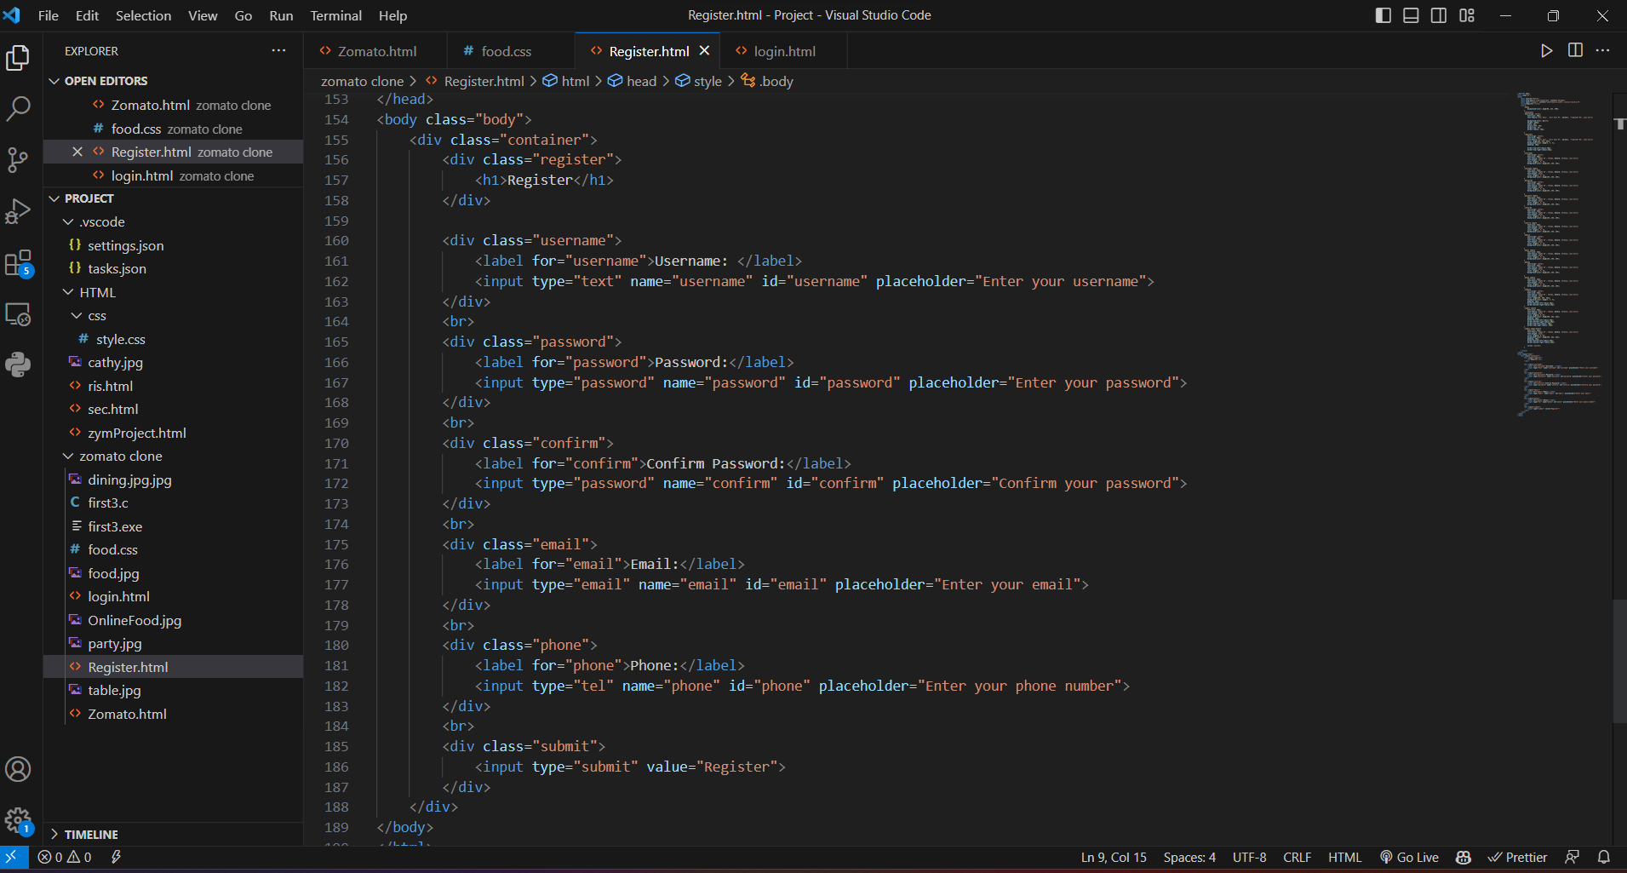

Slide 11
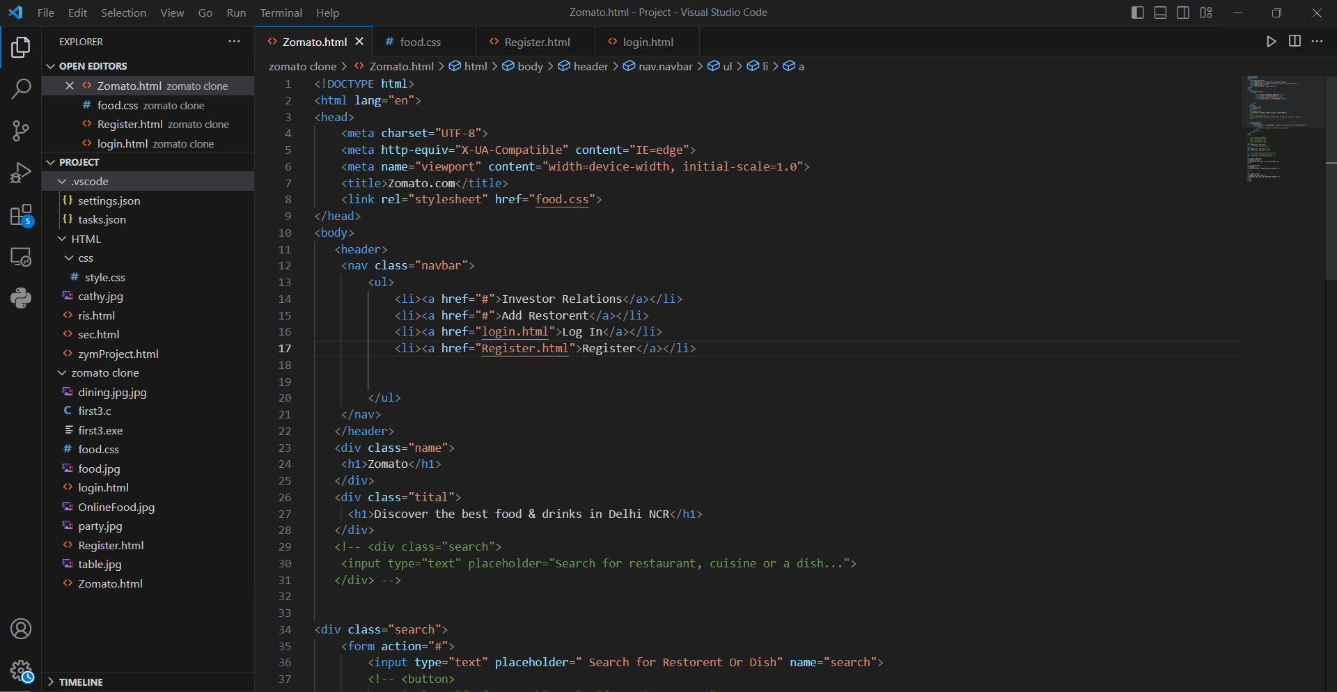
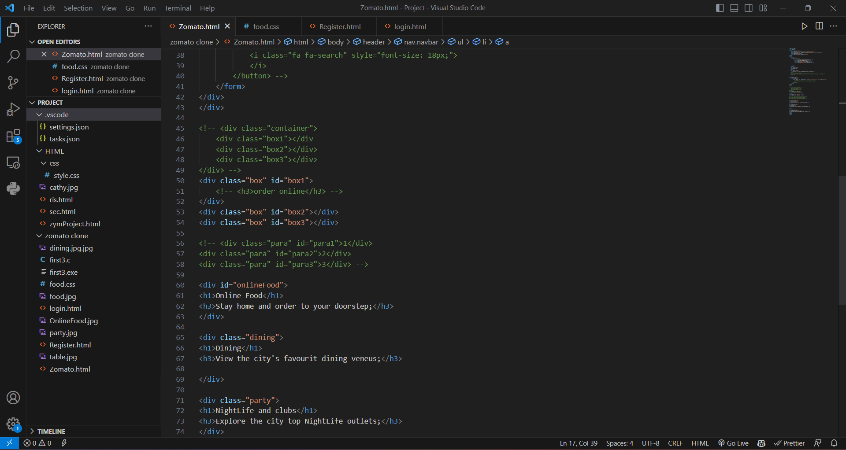

Slide 12
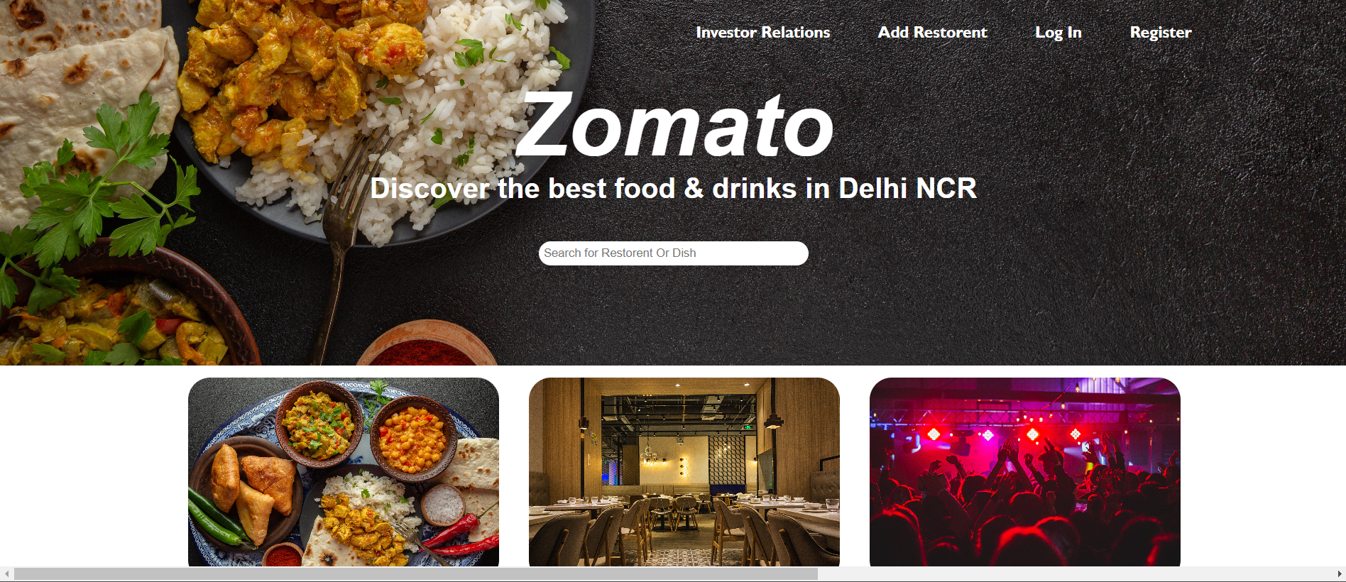
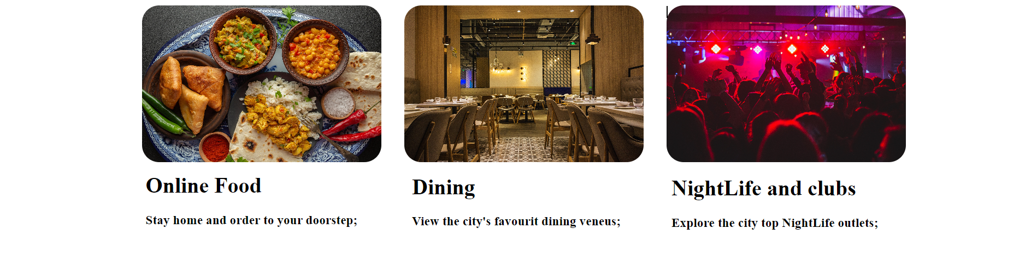
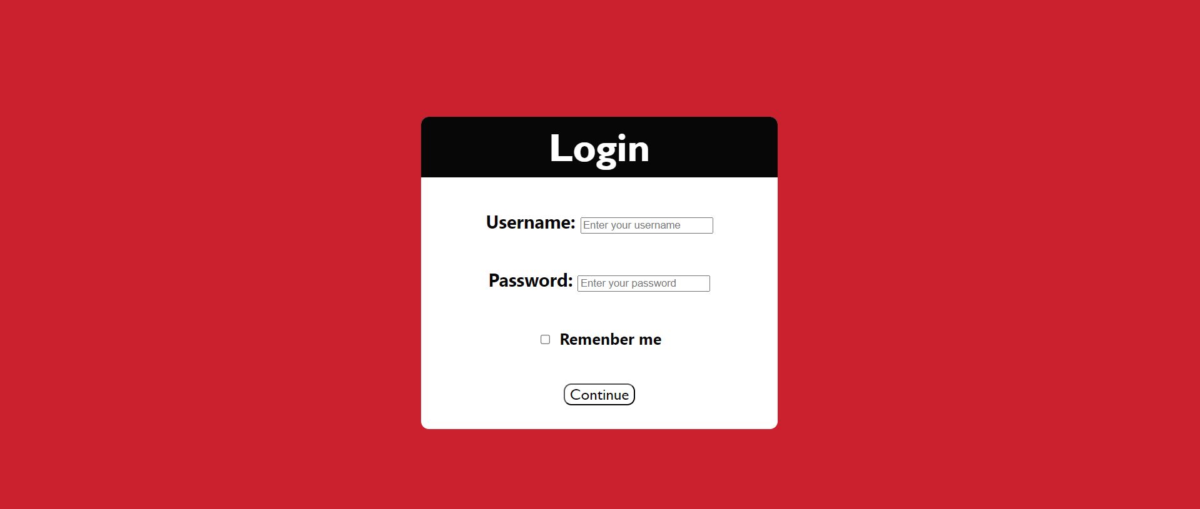
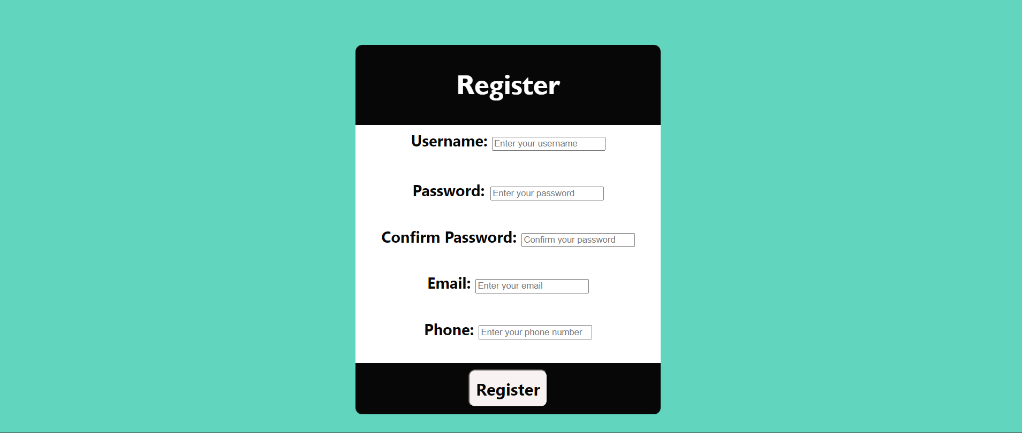
Results:-

Slide 13
Links:-
GitHub repositories:-
https://github.com/ankitsisodiya623/OCTANET_JUNE

